Slide 1

Project Analysis Presentation
Lior Elayev
GitHub

Slide 2
Project analysis slide 2
Project Analysis
Research questions:
*What creates the success of a football player?
*Is it possible to predict how much a football player will cost in the future?
Data
Acquisition
Data
Cleaning
Data
Handling
EDA & Visualization
Machine Learning

Slide 3
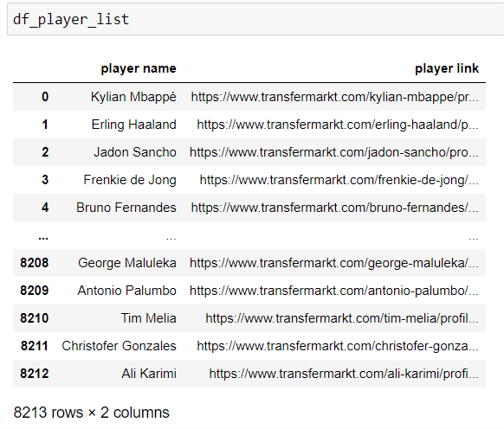
Project analysis slide 4
Crawling
Data
Acquisition
I used a built-in function from “pandas” to crawl the relevant data from www.transfermarkt.com website.
The data that I crawled is from the biggest increases in market value since Jan 1, 2017.
I pulled the data in 3 steps:
Step 1: Running on players data pages, saving in a dataframe the name of each player and the link to his information page

Slide 4
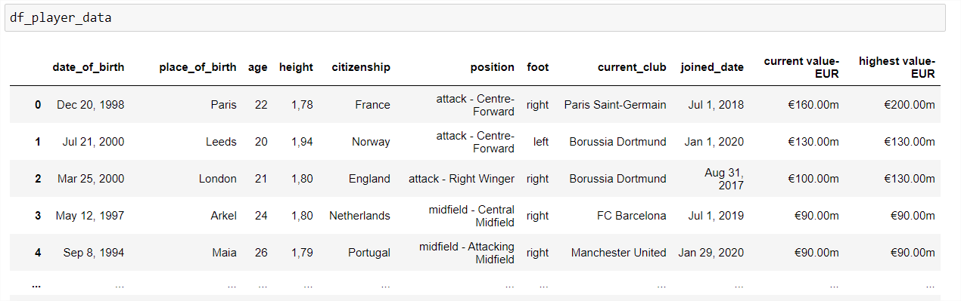
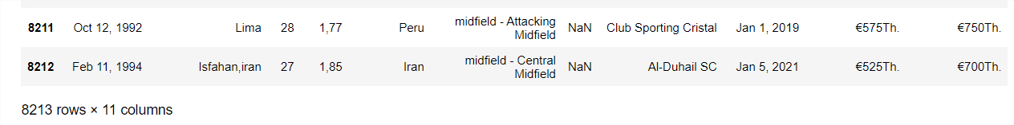
Project analysis slide 4
Crawling
Step 2: Running on each player page, saving in a dataframe the player information (age, height, citizenship, etc.)
Data
Acquisition

Slide 5
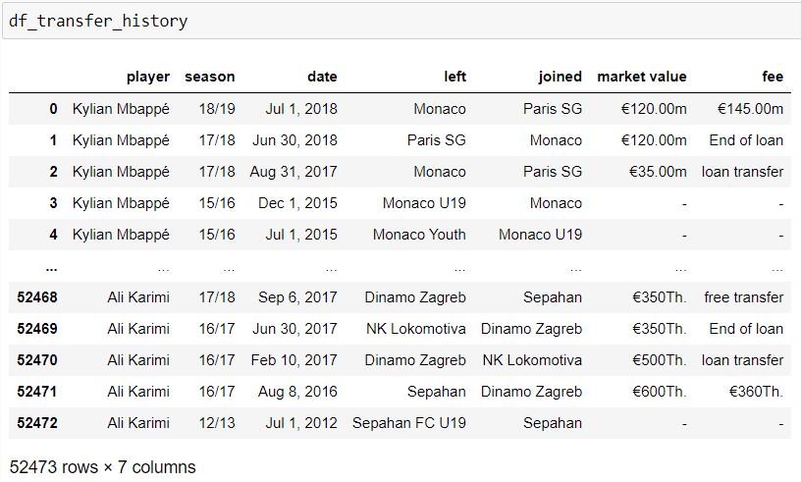
Project analysis slide 4
Crawling
Step 3: Running on each page, saving in a dataframe the player transfer data
Data
Acquisition

Slide 6
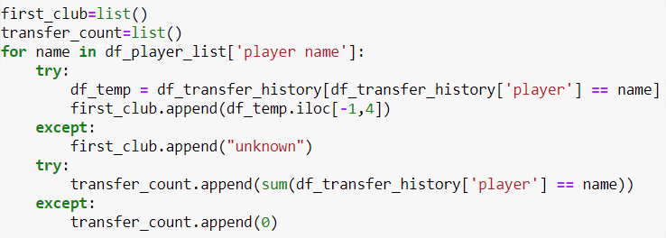
Project analysis slide 4
Crawling
*According to the transfer_history table, I calculated how many times a player was transferred between teams in his career and what was his first team he played for:
Data
Acquisition
*I used a try and except mechanism to handle missing data

Slide 7
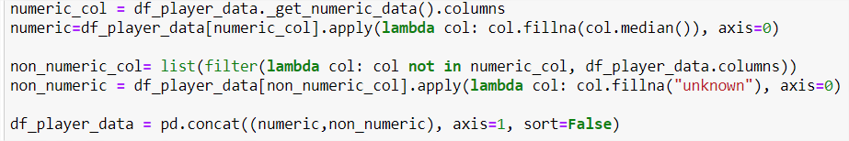
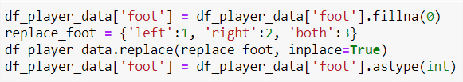
Project analysis slide 4
Data Cleaning & Handling
*Clearing the data from unwanted marks
*Convert players price to a number format
*Changing data types (from objects to int/float)
*Handling missing data by median / “unknown” value
*I set a dictionary for values like "foot"
Data
Acquisition
Data
Cleaning
Data
Handling

Slide 8
Project analysis slide 10
EDA & Visualization
*I tried to find correlations between variables without success.
*I used corr() method for numeric columns and chi2 for non-numeric columns
EDA & Visualization

Slide 9
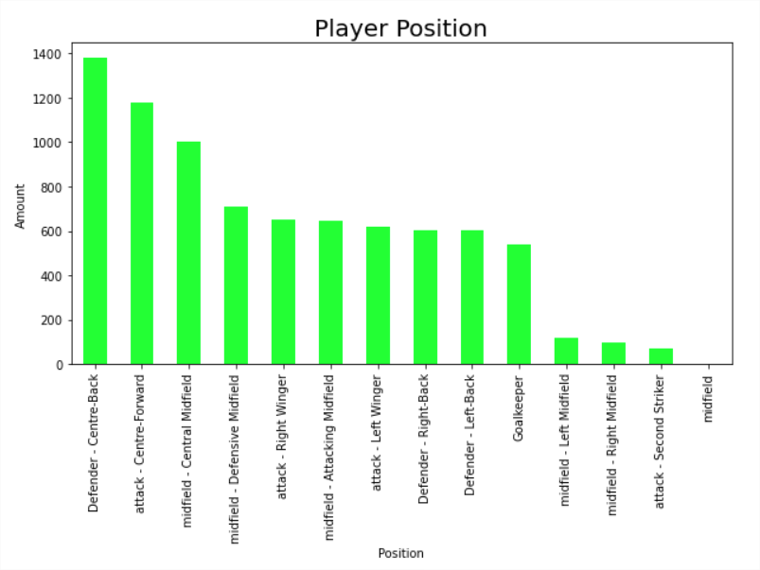
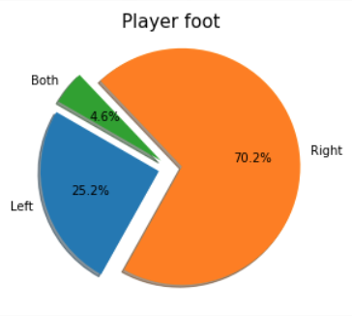
Project analysis slide 10
EDA & Visualization
EDA & Visualization

Slide 10
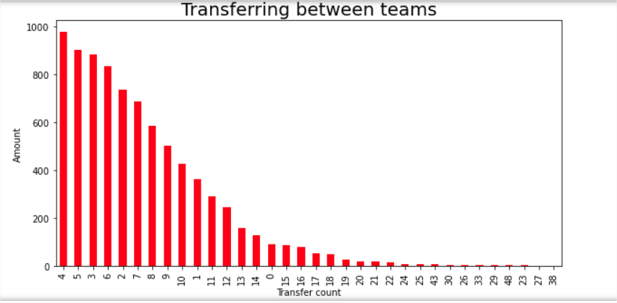
Project analysis slide 10
EDA & Visualization
EDA & Visualization

Slide 11
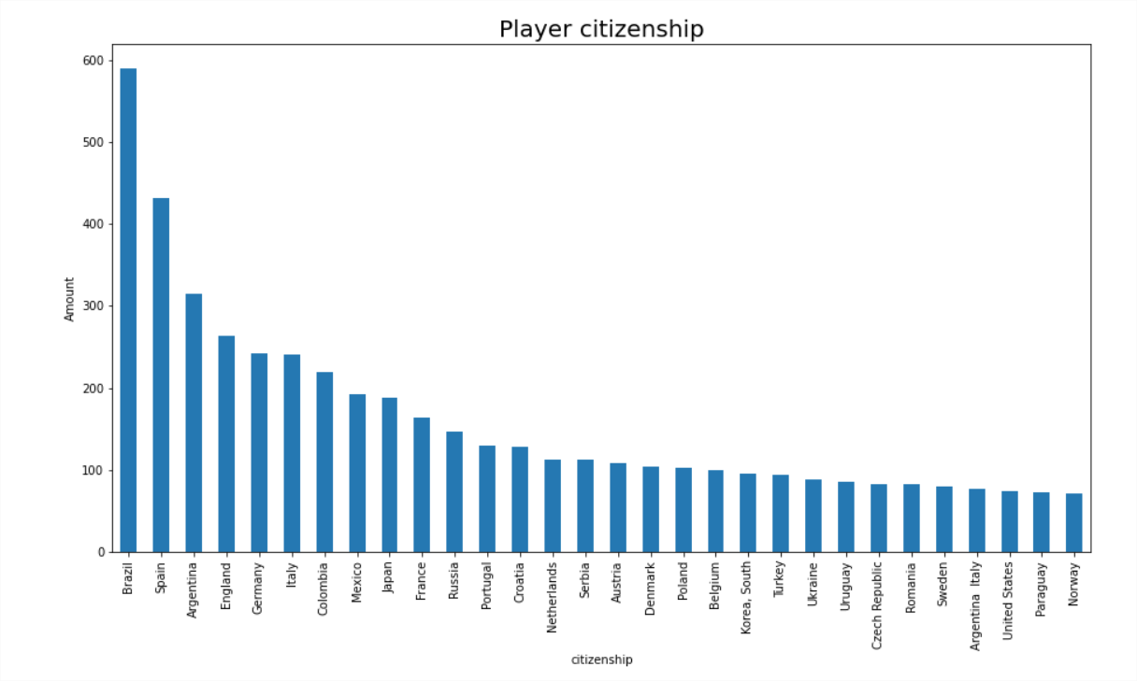
Project analysis slide 10
EDA & Visualization
EDA & Visualization

Slide 12
Project analysis slide 10
ML
Machine Learning
My label is “highest value-EUR” column, because my research question refer to how much a football player will cost in the future
I chose to apply LinearRegression with R^2 index – Supervised Learning for continuous numeric value
The R ^ 2 value generated from the model is
I applied machine learning process:
Dividing the data frame: features and label (status).
Dividing features and label to train and test (train = 80%, test = 20%).
Scaling
Encoding
Fit & Predict
PCA
Accuracy

Slide 13
Thank You

